Slide 1
Airlines Booking Prediction

Slide 2
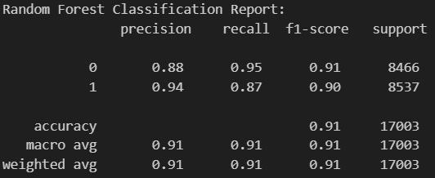
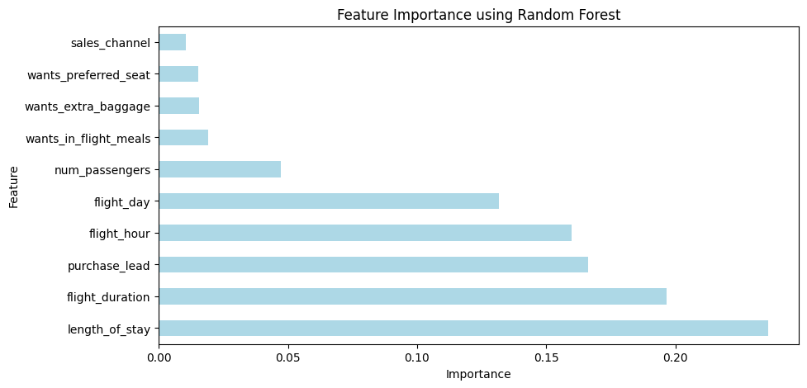
Key Insights:
Random Forest provides more balanced predictions across both classes
Random Forest might be preferable if missing completed bookings is costly
Length of Stay:
Longer vs shorter stays show different completion patterns
May reflect business vs vacation travel behavior
Flight Duration:
Longer flights suggest more planned travel
Short-haul vs long-haul flights show distinct booking patterns
Purchase Lead Time:
Early bookings typically indicate planned trips with higher completion
Last-minute bookings have increased cancellation risk

